Slide 1
Data Mining Classification: Alternative Techniques
Lecture Notes for Chapter 4
Rule-Based
Introduction to Data Mining , 2nd Edition
by
Tan, Steinbach, Karpatne, Kumar

Slide 2
Rule-Based Classifier
Classify records by using a collection of “if…then…” rules
Rule: (Condition) → y
where
Condition is a conjunction of tests on attributes
y is the class label
Examples of classification rules:
(Blood Type=Warm) ∧ (Lay Eggs=Yes) → Birds
(Taxable Income < 50K) ∧ (Refund=Yes) → Evade=No

Slide 3
Rule-based Classifier (Example)
R1: (Give Birth = no) ∧ (Can Fly = yes) → Birds
R2: (Give Birth = no) ∧ (Live in Water = yes) → Fishes
R3: (Give Birth = yes) ∧ (Blood Type = warm) → Mammals
R4: (Give Birth = no) ∧ (Can Fly = no) → Reptiles
R5: (Live in Water = sometimes) → Amphibians

Slide 4
Application of Rule-Based Classifier
A rule r covers an instance x if the attributes of the instance satisfy the condition of the rule
R1: (Give Birth = no) ∧ (Can Fly = yes) → Birds
R2: (Give Birth = no) ∧ (Live in Water = yes) → Fishes
R3: (Give Birth = yes) ∧ (Blood Type = warm) → Mammals
R4: (Give Birth = no) ∧ (Can Fly = no) → Reptiles
R5: (Live in Water = sometimes) → Amphibians
The rule R1 covers a hawk => Bird
The rule R3 covers the grizzly bear => Mammal

Slide 5
Rule Coverage and Accuracy
Coverage of a rule:
Fraction of records that satisfy the antecedent of a rule
Accuracy of a rule:
Fraction of records that satisfy the antecedent that also satisfy the consequent of a rule
(Status=Single) → No
Coverage = 40%, Accuracy = 50%

Slide 6
How does Rule-based Classifier Work?
R1: (Give Birth = no) ∧ (Can Fly = yes) → Birds
R2: (Give Birth = no) ∧ (Live in Water = yes) → Fishes
R3: (Give Birth = yes) ∧ (Blood Type = warm) → Mammals
R4: (Give Birth = no) ∧ (Can Fly = no) → Reptiles
R5: (Live in Water = sometimes) → Amphibians
A lemur triggers rule R3, so it is classified as a mammal
A turtle triggers both R4 and R5
A dogfish shark triggers none of the rules

Slide 7
Characteristics of Rule Sets: Strategy 1
Mutually exclusive rules
Classifier contains mutually exclusive rules if the rules are independent of each other
Every record is covered by at most one rule
Exhaustive rules
Classifier has exhaustive coverage if it accounts for every possible combination of attribute values
Each record is covered by at least one rule

Slide 8
Characteristics of Rule Sets: Strategy 2
Rules are not mutually exclusive
A record may trigger more than one rule
Solution?
Ordered rule set
Unordered rule set – use voting schemes
Rules are not exhaustive
A record may not trigger any rules
Solution?
Use a default class

Slide 9
Ordered Rule Set
Rules are rank ordered according to their priority
An ordered rule set is known as a decision list
When a test record is presented to the classifier
It is assigned to the class label of the highest ranked rule it has triggered
If none of the rules fired, it is assigned to the default class
R1: (Give Birth = no) ∧ (Can Fly = yes) → Birds
R2: (Give Birth = no) ∧ (Live in Water = yes) → Fishes
R3: (Give Birth = yes) ∧ (Blood Type = warm) → Mammals
R4: (Give Birth = no) ∧ (Can Fly = no) → Reptiles
R5: (Live in Water = sometimes) → Amphibians

Slide 10
Rule Ordering Schemes
Rule-based ordering
Individual rules are ranked based on their quality
Class-based ordering
Rules that belong to the same class appear together

Slide 11
Building Classification Rules
Direct Method:
Extract rules directly from data
Examples: RIPPER, CN2, Holte’s 1R
Indirect Method:
Extract rules from other classification models (e.g. decision trees, neural networks, etc).
Examples: C4.5rules

Slide 12
Direct Method: Sequential Covering
Start from an empty rule
Grow a rule using the Learn-One-Rule function
Remove training records covered by the rule
Repeat Step (2) and (3) until stopping criterion is met

Slide 13
Example of Sequential Covering

Slide 14
Example of Sequential Covering…

Slide 15
Rule Growing
Two common strategies

Slide 16
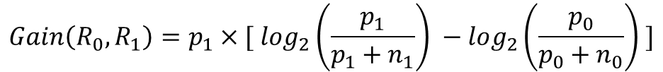
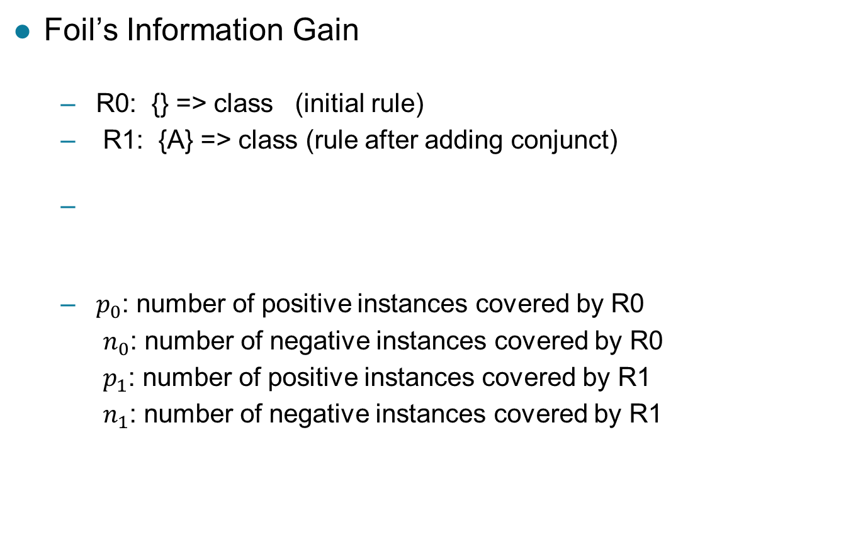
Rule Evaluation
FOIL: First Order Inductive Learner – an early rule-based learning algorithm
Foil’s Information Gain
R0: {} => class (initial rule)
R1: {A} => class (rule after adding conjunct)
$p_{0}$: number of positive instances covered by R0
$n_{0}$: number of negative instances covered by R0
$p_{1}$: number of positive instances covered by R1
$n_{1}$: number of negative instances covered by R1
$$Gain\left(R_{0},R_{1}\right)=p_{1}×[ log_{2}\left(\frac{p_{1}}{p_{1}+n_{1}}\right) −log_{2}\left(\frac{p_{0}}{p_{0}+n_{0}}\right) ]$$

Slide 17
Direct Method: RIPPER
For 2-class problem, choose one of the classes as positive class, and the other as negative class
Learn rules for positive class
Negative class will be default class
For multi-class problem
Order the classes according to increasing class prevalence (fraction of instances that belong to a particular class)
Learn the rule set for smallest class first, treat the rest as negative class
Repeat with next smallest class as positive class

Slide 18
Direct Method: RIPPER
Growing a rule:
Start from empty rule
Add conjuncts as long as they improve FOIL’s information gain
Stop when rule no longer covers negative examples
Prune the rule immediately using incremental reduced error pruning
Measure for pruning: v = (p-n)/(p+n)
p: number of positive examples covered by the rule in the validation set
n: number of negative examples covered by the rule in the validation set
Pruning method: delete any final sequence of conditions that maximizes v

Slide 19
Direct Method: RIPPER
Building a Rule Set:
Use sequential covering algorithm
Finds the best rule that covers the current set of positive examples
Eliminate both positive and negative examples covered by the rule
Each time a rule is added to the rule set, compute the new description length
Stop adding new rules when the new description length is d bits longer than the smallest description length obtained so far

Slide 20
Direct Method: RIPPER
Optimize the rule set:
For each rule r in the rule set R
Consider 2 alternative rules:
Replacement rule (r*): grow new rule from scratch
Revised rule(r′): add conjuncts to extend the rule r
Compare the rule set for r against the rule set for r* and r′
Choose rule set that minimizes MDL principle
Repeat rule generation and rule optimization for the remaining positive examples

Slide 21
Indirect Methods

Slide 22
Indirect Method: C4.5rules
Extract rules from an unpruned decision tree
For each rule, r: A → y,
consider an alternative rule r′: A′ → y where A′ is obtained by removing one of the conjuncts in A
Compare the pessimistic error rate for r against all r’s
Prune if one of the alternative rules has lower pessimistic error rate
Repeat until we can no longer improve generalization error

Slide 23
Indirect Method: C4.5rules
Instead of ordering the rules, order subsets of rules (class ordering)
Each subset is a collection of rules with the same rule consequent (class)
Compute description length of each subset
Description length = L(error) + g L(model)
g is a parameter that takes into account the presence of redundant attributes in a rule set (default value = 0.5)

Slide 24
Example

Slide 25
C4.5 versus C4.5rules versus RIPPER
C4.5rules:
(Give Birth=No, Can Fly=Yes) → Birds
(Give Birth=No, Live in Water=Yes) → Fishes
(Give Birth=Yes) → Mammals
(Give Birth=No, Can Fly=No, Live in Water=No) → Reptiles
( ) → Amphibians
RIPPER:
(Live in Water=Yes) → Fishes
(Have Legs=No) → Reptiles
(Give Birth=No, Can Fly=No, Live In Water=No) → Reptiles
(Can Fly=Yes,Give Birth=No) → Birds
() → Mammals

Slide 26
C4.5 versus C4.5rules versus RIPPER
C4.5 and C4.5rules:
RIPPER:

Slide 27
Advantages of Rule-Based Classifiers
Has characteristics quite similar to decision trees
As highly expressive as decision trees
Easy to interpret (if rules are ordered by class)
Performance comparable to decision trees
Can handle redundant and irrelevant attributes
Variable interaction can cause issues (e.g., X-OR problem)
Better suited for handling imbalanced classes
Harder to handle missing values in the test set

